Slide 2
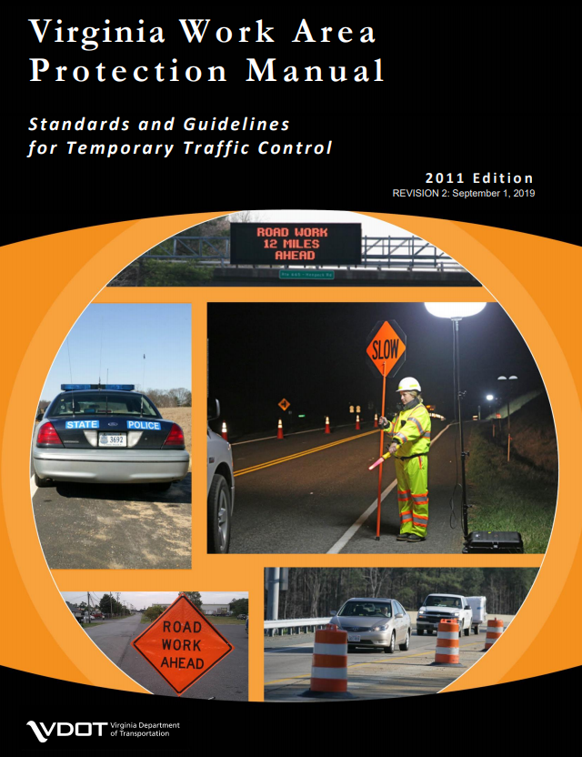
Virginia work area protection manual – Revision 2 Update
Presenter’s Name
May 28, 2019
Notes:
This presentation will conver some of the more significant changes in Revision 2 to the 2011 VA WAPM.

Slide 3
Added reference to the following documents:
Work Zone Pedestrian and Bicycle Guidance document
VDOT guidelines for the Installation of Marked Crosswalks
Chapter 14 of the FHWA Shared Use Path Design
Section 1300 of the Road and Bridge Standards
Part 6 and 9 of the MUTCD
IIM-LD-55 and IIM-TED-384 to address control of pedestrians and bicyclists through a TTC zone
Revised throughout
Revised “Regional” Traffic Engineer to “District” Traffic Engineer
Notes:
Throughout Revision 2 has been added references to pedestrian and bicycle user work zone guidance documents and information.
Also, due to the change from Regional Traffic Engineer back to District Traffic Engineer this term has been revised throughout Revision 2.

Slide 4

FLAGGER UPDATES
Flaggers control all road users
  Vehicles
  Pedestrians
  Bicycles
Coordinates traffic movement on the mainline and intersecting roadways.
Require radio communication between all flaggers and pilot vehicle operators.
Notes:
A number of changes or improvements have been made regarding Flagger activities:
Flaggers control all road users
Vehicles
Pedestrians
Bicycles
Coordinates traffic movement on the mainline and intersecting roadways.
Require radio communication between all flaggers and pilot vehicle operators.

Slide 5
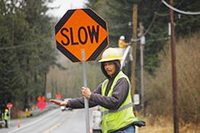
FLAGGER UPDATES
Removed Flag Transfer Method (also no longer in the Flagger training video).
One flagger may control traffic on low volume roadways (500 vpd or less) & good visibility to each end of the work zone. Otherwise, two flaggers are required.
Flaggers stand on the shoulder or as close as possible, never entering the travel lane used by stopped or moving traffic.
Notes:
The Flag Transfer method has been removed since it’s been a while since this process was used. It’s also been removed from the recent revised Flagger training video.
One flagger may control traffic on low volume roadways (500 vpd or less) & good visibility to each end of the work zone. Otherwise, two flaggers are required.
Flaggers stand on the shoulder or as close as possible, never entering the travel lane used by stopped or moving traffic.

Slide 6
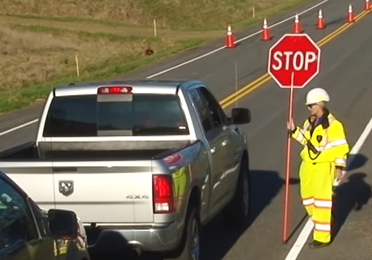
FLAGGER UPDATES
Flaggers speaks to motorist from the passenger side, DO NOT touch vehicles. Flaggers shall not use cell phones or other similar devices. Flagger controls movements at intersections with references to TTC-30 & TTC-67. Day or Night flaggers shall wear full length Class E trousers or overalls.
Notes:
An important safety feature added for flagger safety is removing the flagger from entering the roadway. Flagging operations should always be performed from the roadway shoulder.
Also, Flaggers shall not use cell phones or other similar devices. Due to their distracted nature.
To improve flagger visibility, beginning September 1 all flaggers will be required to wear the Class E trouser during both day and night operations.

Slide 7

FLAGGER UPDATES
Guidance Statements Added: Stoppage Timeframes 8 Minutes For High Volume Roadways (500 Vehicles Or > Per Day) 12 Minutes For < 500 Vehicles Per Day PCMS recommended with stoppage greater than 12 Minutes Option Statements: Flagger may need to control access to private entrances/driveways as directed by the engineer with advance notification to the property owner.
10 minutes for high volume roadways
Notes:
The following guidance statement has been added for the stoppage of traffic by flaggers:
8 Minutes For High Volume Roadways (500 Vehicles Or > Per Day)
12 Minutes For < 500 Vehicles Per Day
The guidance was added due to complaints received by the Secretary of Transportation on long wait time by motorists in flagging operations. There was no written guidance in the WAPM covering this. If for some reason a longer stoppage time is needed, then a PCMS will need to be used displaying what the wait time may be to better communicate to motorists.
An option statement was added covering there may be a need to control access to private entrances or driveways or at least communicate that you will be out there controlling traffic in a one lane travel situation.

Slide 8
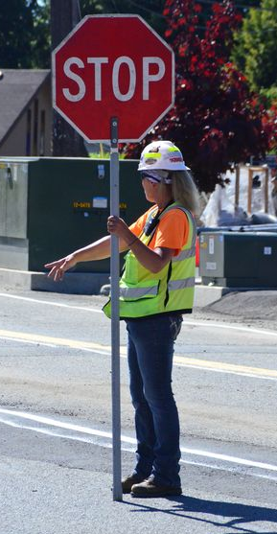

Flagger Station at Railroad Crossing
Coordination with the railroad required for railroad flagger and watchperson services
10 minutes for high volume roadways
Notes:
Coordination with the railroad required for railroad flagger and watchperson services when working near a rail crossing.

Slide 9
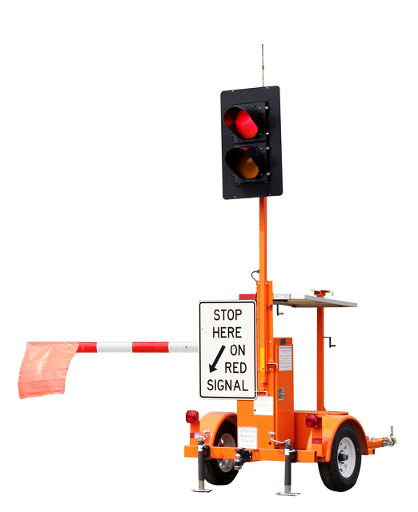
AUTOMATED FLAGGING ASSISTANCE DEVICE (AFAD)
When used, an AFAD shall only operated by a certified flagger
The operator must have an unobstructed view of the Automatic Flagger Assistance Device and approaching traffic in both directions or if the AFAD is working on its own individual network, cameras may be used at each device to view traffic from both directions
Delineated with a 4 Cone Taper.
If unmanned with a 4 Drum Taper.
AFAD Figures added to Section 6H
Notes:
Additional information on the use of Automated Flagger Assistance Devices (AFAD) was added or changed:
When used, an AFAD shall only operated by a certified flagger
The operator must have an unobstructed view of the Automatic Flagger Assistance Device and approaching traffic in both directions or if the AFAD is working on its own individual network, cameras may be used at each device to view traffic from both directions
Delineated with a 4 Cone Taper.
If unmanned with a 4 Drum Taper.
AFAD Figures added to Section 6H

Slide 10
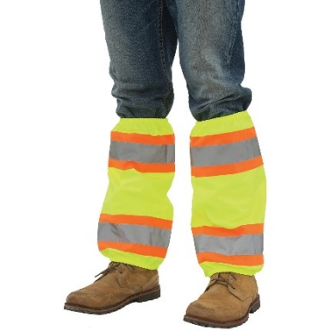

HIGH-VISIBILITY APPAREL
Prohibits use of Leg Gaiters or Chaps in lieu of Type E Trousers for workers installing, maintaining, or removing TTC devices
Workers not installing TTC may wear leg gaiters as an option
Allows utility flaggers to wear fire-retardant leg gaiters or chaps
Lights internal to the high visibility apparel shall be steady burn yellow, white, or yellow-green
Notes:
To increase the visibility of workers, the following has been added:
Prohibits use of Leg Gaiters or Chaps in lieu of Type E Trousers for workers installing, maintaining, or removing TTC devices
Workers not installing TTC may wear leg gaiters as an option
Allows utility flaggers to wear fire-retardant leg gaiters or chaps
Lights internal to the high visibility apparel shall be steady burn yellow, white, or yellow-green

Slide 11
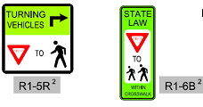
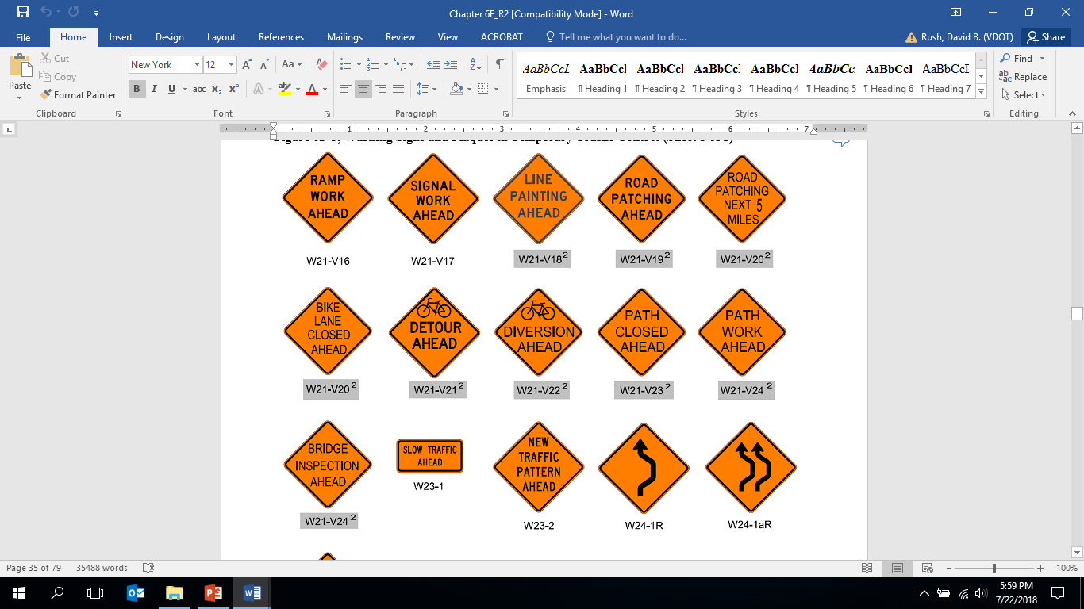
PEDESTRIAN & BICYCLE
Table 6F-1 added pedestrian and bicycle signs, corrected/added section references and sizes
New section for TTC regulatory signs for pedestrian & bicycle traffic
Added “Bike Lane Closed” and “Path Closed Signs”
New section for TTC warning signs for pedestrian & bicycle traffic.
Figure 6F-3 Regulatory Signs and Plaques.
Figure 6F-4 Warning Signs and Plaques.
Figure 6F-5 Detours.
Notes:
Signs covering pedestrian and bicyclists have been added.

Slide 12
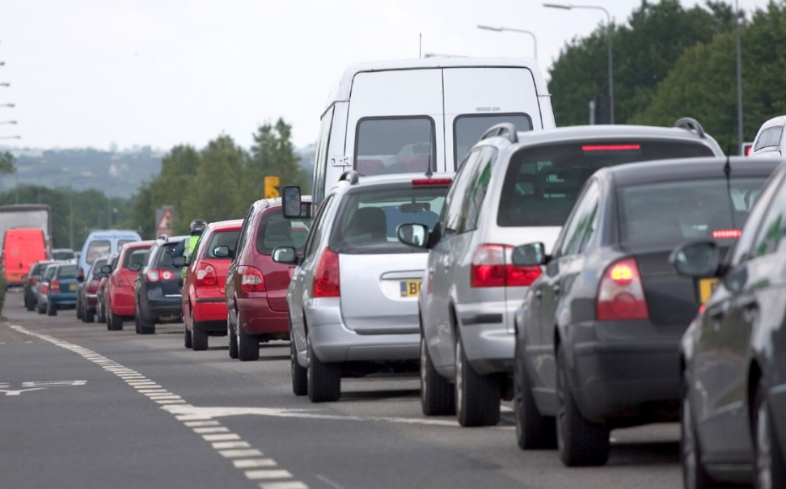
CHAPTER 6A - General
Added Queue Management System definition
  A system that warns motorists of potential slowed or stopped traffic. The system can consist of warning signs, queue management vehicles or ITS technology.
Notes:
A definition for what a traffic queue is was added. The Staunton district has been active and successful in providing advanced warning of slowed or stopped traffic on many of their interstate operations.

Slide 13
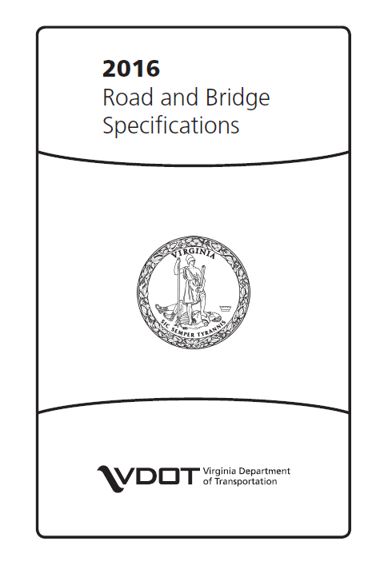
CHAPTER 6F – Temporary Traffic Control Zone Devices
Specification Language Removed
  Removed listing of sign substrates and rigid sign materials since this is covered in the R&B Specifications.
  Removed PTRS Details since this is also covered in the R&B Specifications.
Notes:
To prevent the possibility of having conflicting information in two documents, language currently shown in the R&B Specifications has been removed in the WAPM
Removed listing of sign substrates and rigid sign materials since this is covered in the R&B Specifications.
Removed PTRS Details since this is also covered in the R&B Specifications.

Slide 14
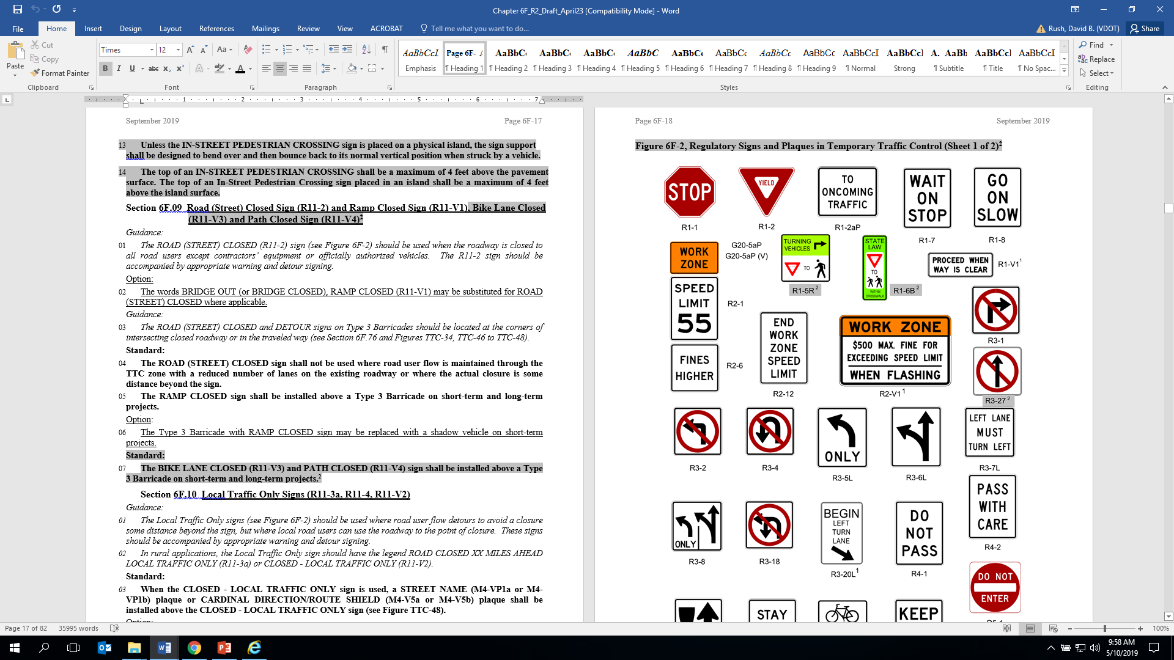
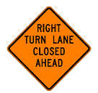
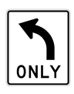
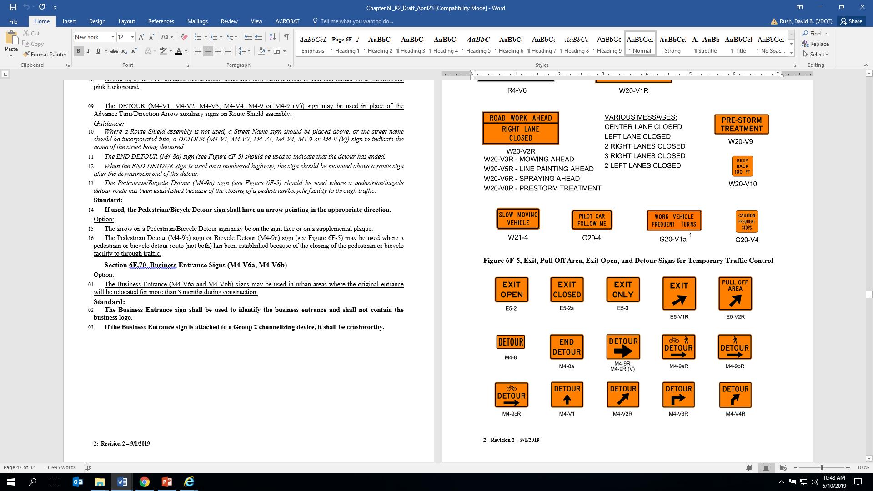
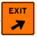
CHAPTER 6F – Temporary Traffic Control Zone Devices
Portable Sign Stands – 5’ To Bottom Of Sign for:
  Stop & Yield;
  Left/Right Turn Lane Open & Left/Right Turn Lane Closed;
  Turn Lane with Arrow;
  Exit Open & Exit Closed;
  Exit w/Arrow - Arrow must match permanent exit Arrow
Notes:
The height for some signs on portable sign supports has been dropped from 7 foot to 5 foot. These are normally signs used near on and off ramps.

Slide 15
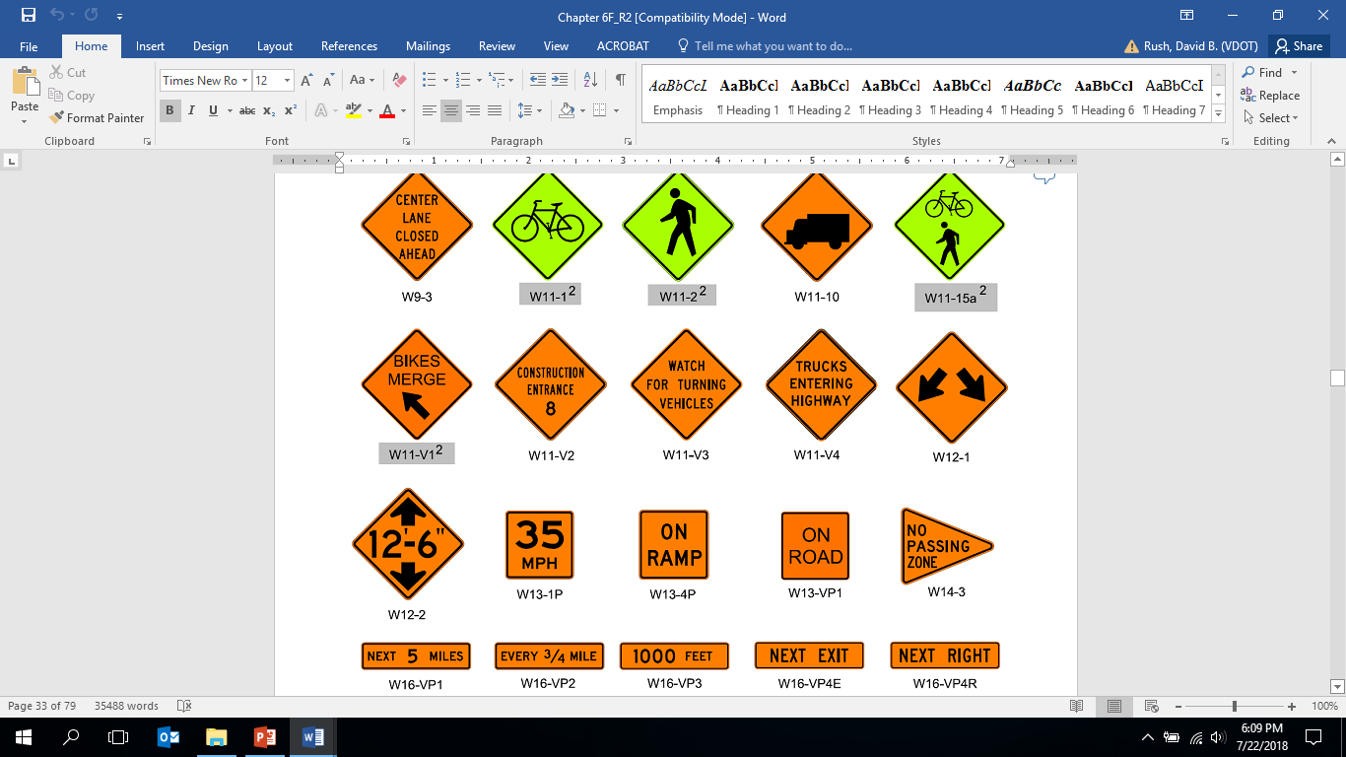
CHAPTER 6F – Temporary Traffic Control Zone Devices
Construction Entrance (W11-V2)
  Sign should be used to identify Ingress Points for deliveries.
Trucks Entering Highway (W11-V4)
  Sign should be used to identify Egress Points for trucks entering roadways on large scale projects.
Notes:
Signs for warning of vehicles entering and exiting a work long term work zone has been added. As well as a way to identify ingress points by delivery vehicles.

Slide 16
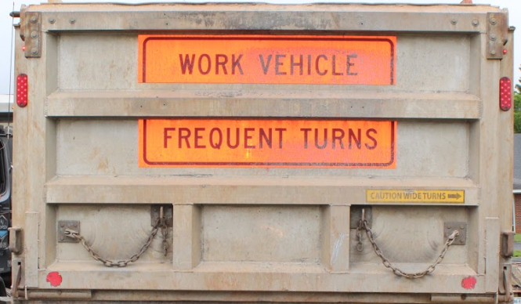
CHAPTER 6F – Temporary Traffic Control Zone Devices
Work Vehicle Frequent Turns
  Measured vertically from the bottom of the sign to the pavement a minimum of 4 feet and can be modified to fit indentions of the truck tailgate
    Letters cannot be modified
    Allows for sign to be cut in two
    Eliminates border if necessary
Notes:
Work Vehicle Frequent Turns
Measured vertically from the bottom of the sign to the pavement a minimum of 4 feet and can be modified to fit indentions of the truck tailgate
Letters cannot be modified
Allows for sign to be cut in two
Eliminates border if necessary (but not preferred)

Slide 17
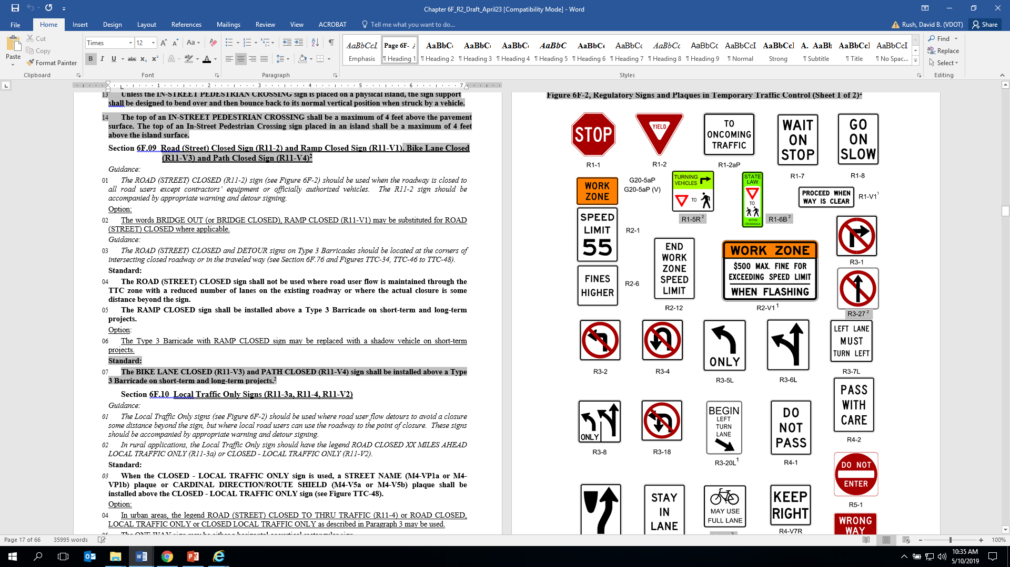
CHAPTER 6F – Temporary Traffic Control Zone Devices
Begin Left/Right Turn Lane with Arrow
  Shall be used on long-term conditions (for longer than 3 consecutive days) in conjunction with the LEFT/RIGHT TURN LANE OPEN and placed at the beginning of the turn lane taper or the open turn lane.
Notes:
Signs for marking turn lanes has been added for long term projects.

Slide 18
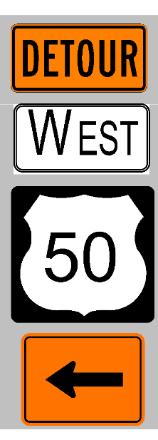
CHAPTER 6F – Temporary Traffic Control Zone Devices
Detour Signs
  Sizes may be reduced with the DTE approval.
Programmable Changeable Message Sign (PCMS)
  Optional on shadow vehicles - 10ʺ letters.
  When closing a lane on a multi-lane highway, if all of the advance warning signs cannot be installed on both the right and left side of the highway, a PCMS displaying lane closure information should be used in advance of the first warning sign.
Notes:
The size of Detour signs may be reduced but must be approved by the District traffic Engineer.
For roadways where a median is not provided or wide enough to place warning signs on both sides of a multilane highway, then a PCMS should be incorporated into the advanced warning area for greater visibility to motorist.

Slide 19

CHAPTER 6F – Temporary Traffic Control Zone Devices
Channelizing Devices
  Wherever 4 X Speed was noted in TTC’s is now changed to normal spacing of channelizing devices
  Cones used to delineate AFADS
  All drums shall meet Section 247 of the R&B Specifications (date referenced removed)
  Drums required for exit ramp tapers
  Type 3 Barricades should extend fully across sidewalks and bicycle lanes or paths
Notes:
Channelizing Devices
Wherever 4 X Speed was noted in TTC’s is now changed to normal spacing of channelizing devices
Cones used to delineate AFADS
All drums shall meet Section 247 of the R&B Specifications (date referenced removed)
Drums required for exit ramp tapers
Type 3 Barricades should extend fully across sidewalks and bicycle lanes or paths

Slide 20
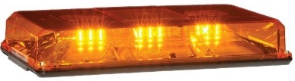
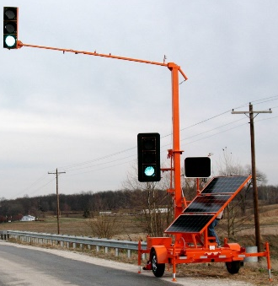
CHAPTER 6F – Temporary Traffic Control Zone Devices
Vehicle Warning Lights
  No Flashing White Lights of any kind (violates Vehicle Code Of VA)
  Amber lights required on equipment w/ rollers or wheels (provides warning to workers on foot)
  DAY & Night shall have 360°visability
Temporary Signal
  Field adjustment must comply w/ Section 512 of the R&B Specs.
  Portable Temporary Signal must be delineated w/ a 4 drum taper
Notes:
Vehicle Warning Lights
No Flashing White Lights of any kind allowed on vehicle since it violates the Vehicle Code of VA
Amber lights Required on equipment w/ rollers or wheels (provides warning to workers on foot)
Lights shall be activated both DAY & Night and shall have 360°visability
Temporary Signal
Field adjustment must comply w/ Section 512 of the R&B Specs.
Portable Temporary Signal must be delineated w/ a 4 drum taper

Slide 21
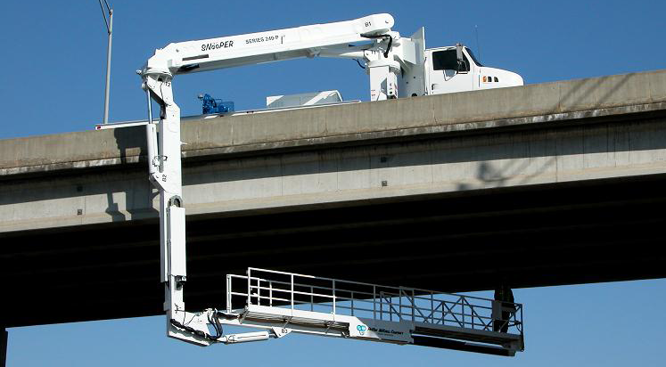
CHAPTER 6F – Temporary Traffic Control Zone Devices
Shadow Vehicle With Truck Mounted Attenuator
  Required on shoulders of multilane roadways w/ a posted speed of 45 mph or greater for operations w/ a duration greater than 60 minutes to resolve conflict between TTC-3 and TTC-5
  Required with Snooper Truck Operations regardless of the posted speed limit
Notes:
A Shadow Vehicle with a Truck Mounted Attenuator shall be used on all Snooper Truck Operations regardless of the posted speed limit due to the vulnerability of the workers who can’t see or respond to errant vehicles..
A Shadow Vehicle with a Truck Mounted Attenuator is also required on shoulders of multilane roadways w/ a posted speed of 45 mph or greater for operations w/ a duration greater than 60 minutes.

Slide 22
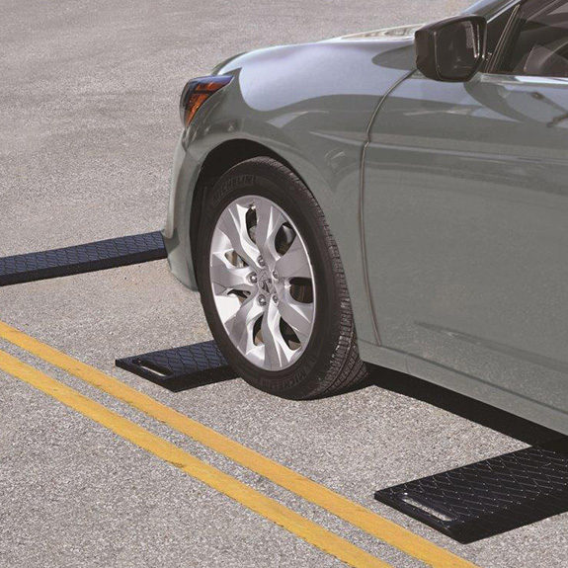
CHAPTER 6F – Temporary Traffic Control Zone Devices
Portable Temporary Rumble Strips (PTRS)
  Work operation occurs on a two-lane stationary and non-stationary daytime flagging operation,
  Work duration in a location is greater than 3 hours but less than three consecutive days (72 consecutive hours); and,
  Existing posted or regulatory speed limit is 35 mph or greater w/ centerline markings (indicates a minimum of 500 vehicles a day) exist.
Notes:
The requirements for the use of PTRS which was in IIM-TE-386.1 has been incorporated into the WAPM:
Work operation occurs on a two-lane stationary and non-stationary daytime flagging operation,
Work duration in a location is greater than 3 hours but less than three consecutive days (72 consecutive hours); and,
Existing posted or regulatory speed limit is 35 mph or greater w/ centerline markings (indicates a minimum of 500 vehicles a day) exist.

Slide 23

CHAPTER 6G – Type of TTC Zone Activities
Work Duration – Current Language
Support:
During short-duration work, it often takes longer to set up and remove the TTC zone than to perform the work. Workers face hazards in setting up and taking down the TTC zone. Also, since the work time is short, delays affecting road users are significantly increased when additional devices are installed and removed.
Option:
Considering these factors, simplified control procedures may be warranted for short-duration work. A reduction in the number of devices may be offset by the use of other more dominant devices such as high-intensity rotating, flashing, or oscillating lights on work vehicles.
Notes:
There has been misinterpretation of this section of 6G where some believe it gives them the right to not use traffic control devices since it takes some time to install them. That was never the intent of this section of the MUTCD, therefore . . .

Slide 24
CHAPTER 6G – Type of TTC Zone Activities
Work Duration – Revision 2
Option:
Considering these factors, simplified control procedures may be warranted for short-duration work. A reduction in the number of devices may be offset by the use of other more dominant devices such as high-intensity rotating, flashing, or oscillating lights on work vehicles. These simplified control procedures are shown in TTC-3, Mobile or Short Duration Shoulder Operation, and TTC-15, Short Duration Operation on a Multi-Lane Roadway.
Standard:
Modifications to standard TTC figures for short-duration operations require approval from the District Traffic Engineer.
Notes:
This section has been better defined as to its purpose and a Standard added stating “Modifications to standard TTC figures for short-duration operations require approval from the District Traffic Engineer.”

Slide 25
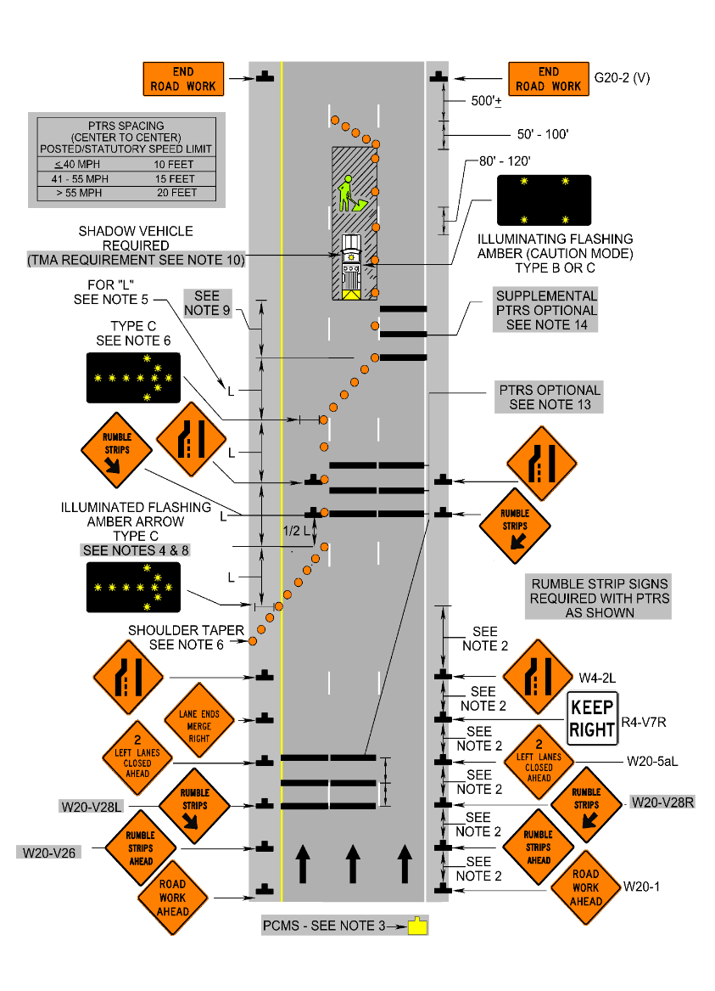
CHAPTER 6G – Type of TTC Zone Activities
Center Lane Closure Added Due To Sunset Of IIM-TE-342
  When the center lane of a multi-lane roadway must be closed for work activities, an additional adjoining lane on one side shall be closed such that through traffic is not split around the work area (see figure TTC-18)
  If the center lane closure must encroach on the remaining lanes, a minimum 11 foot travel lane(s) shall be maintained
Notes:
Due to the sunset of IIM-TE-342, it’s language was added to Section 6G:
When the center lane of a multi-lane roadway must be closed for work activities, an additional adjoining lane on one side shall be closed such that through traffic is not split around the work area (see figure TTC-18)
If the center lane closure must encroach on the remaining lanes, a minimum 11 foot travel lane(s) shall be maintained

Slide 26
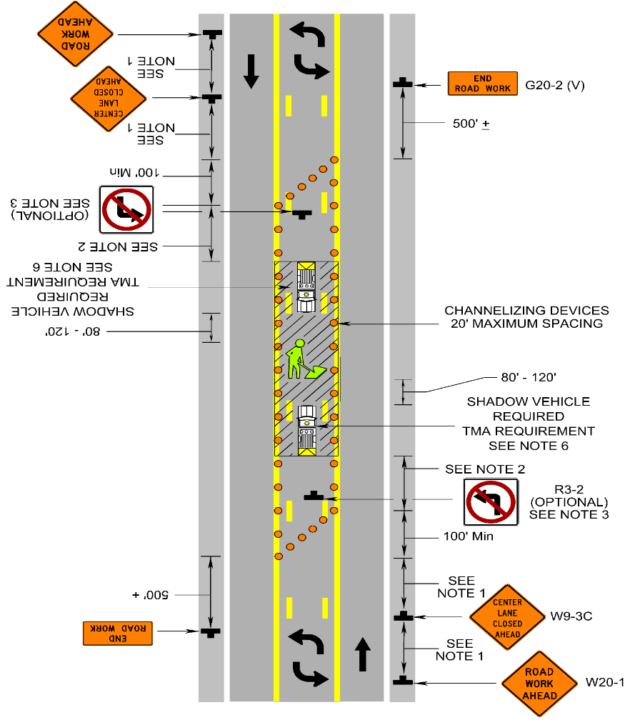
CHAPTER 6G – Type of TTC Zone Activities
Center Lane Closure Added Due To Sunset Of IIM-TE-342
  A center lane shall not be closed when work is only being performed in an adjacent lane unless the lane closure encroached into the center lane resulting in a travel lane width of less than 11 feet
This policy does not apply to center turn lanes on three-lane roadways.
Notes:
A center lane shall not be closed when work is only being performed in an adjacent lane unless the lane closure encroached into the center lane resulting in a travel lane width of less than 11 feet
This policy does not apply to center turn lanes on three-lane roadways.

Slide 27
CHAPTER 6G – Type of TTC Zone Activities
Pull-off Areas on Limited Access Highways
To avoid conflicts with disabled vehicles and construction equipment, the pull-off areas shall not be used as construction ingress/egress points.
Pull-off areas shall be a paved surface defined by barrier or outlined by temporary pavement markings and drums as shown in TTC-8.
Pull-off areas shall be maintained free of debris and other roadway materials.
Notes:
To improve the safety of Pull-off Areas on long term construction projects on Limited Access Highways, the following was added:
To avoid conflicts with disabled vehicles and construction equipment, the pull-off areas shall not be used as construction ingress/egress points.
Pull-off areas shall be a paved surface defined by barrier or outlined by temporary pavement markings and drums as shown in TTC-8.
Pull-off areas shall be maintained free of debris and other roadway materials.

Slide 28

CHAPTER 6G – Type of TTC Zone Activities
Installing & Removing TTC’s
Flagger
  Changes “TTC Spotter” to “Flagger”
  Uses Stop/Slow paddle
  Controls traffic while installing signs and assumes flagger station #1 for that direction and maintains that flagger station
  Flagger #2 controls traffic during the opposite side signs installation then maintains flagger station #2
Notes:
In the section in 6G dealing with Installing and Removing Temporary Traffic Cntrol, the following changes were made:
Changes “TTC Spotter” to “Flagger”
Uses Stop/Slow paddle
Controls traffic while installing signs and assumes flagger station #1 for that direction and maintains that flagger station
Flagger #2 controls traffic during the opposite side signs installation then maintains flagger station #2

Slide 29
CHAPTER 6G – Type of TTC Zone Activities
Installing & Removing TTC’s
Shadow Vehicles
  Work vehicle may be equipped with a TMA; however it must also be protected by a shadow vehicle with a TMA, added reference to TTC-13
Notes:
Some contractors have added TMAs to their work vehicles for added protection, which is fine as long as the work vehicle is also protected by a shadow vehicle with a TMA. Workers shall not work off a shadow vehicle.

Slide 30
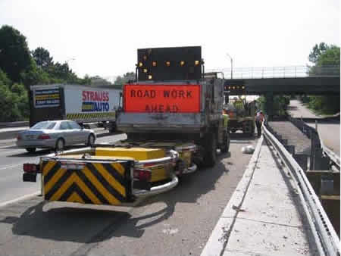
CHAPTER 6G – Type of TTC Zone Activities
Installing & Removing TTC’s
When using standard non-trailer mounted TMA devices, the temporary traffic control devices should be removed against the flow of traffic within the closed travel lane, backing the TMA shadow vehicle while protecting the work vehicle removing the devices.
Notes:
VDOT currently has two types of TMAs: Regular fold over the cab type units and trailer type units. Fold over the cab type units are easier to back up in a closed shoulder or lane operations, where a trailer type unit cannot. Therefore the next couple of slides explains how to perform removal operations with these types of TMAs.
When using standard non-trailer mounted TMA devices, the temporary traffic control devices should be removed against the flow of traffic within the closed travel lane, backing the TMA shadow vehicle while protecting the work vehicle removing the devices.

Slide 31
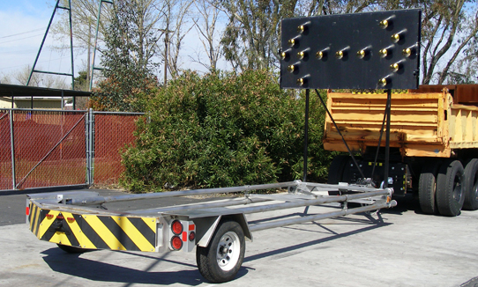
CHAPTER 6G – Type of TTC Zone Activities
Installing & Removing TTC’s
When using trailer mounted TMA devices, the temporary traffic control devices should be removed with the flow of traffic due to the difficulty of backing the trailer mounted devices.
Notes:
When using trailer mounted TMA devices, the temporary traffic control devices should be removed with the flow of traffic due to the difficulty of backing the trailer mounted devices.

Slide 32
CHAPTER 6G – Type of TTC Zone Activities
Removing TTC’s w/ Trailer Mounted TMAs
TTC Devices Should Be Removed With Flow Of Traffic
  To assist with moving traffic over during the removal operation, leave the arrow board operating.
  Remove the channelizing devices with the flow of traffic starting at the merging taper and continue to remove the remaining channelizing devices through the termination area. Remove the END ROAD WORK sign adjacent to the lane
  Remove the advanced warning signs
  Remove the arrow board and its delineation
Notes:
Removing TTC’s w/ Trailer Mounted TMAs
TTC Devices Should Be Removed With Flow Of Traffic
To assist with moving traffic over during the removal operation, leave the arrow board operating.
Remove the channelizing devices with the flow of traffic starting at the merging taper and continue to remove the remaining channelizing devices through the termination area. Remove the END ROAD WORK sign adjacent to the lane
Remove the advanced warning signs
Remove the arrow board and its delineation

Slide 33
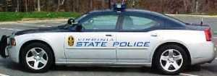
CHAPTER 6G – Type of TTC Zone Activities
Use of Law Enforcement in Work Zones
The use of law enforcement personnel in WZs helps w/ speed compliance and increases driver awareness to WZ conditions
The use of law enforcement personnel is an enhancement to the typical temporary traffic control applications shown in this manual and shall not be used as a substitution or replacement for temporary traffic control devices.
When used in a mobile operation and installing/removing temporary traffic control devices, law enforcement vehicles shall be protected by a shadow vehicle.
Notes:
The use of VSP or other law enforcement is an enhancement to the typical traffic control layout, NOT A REPLACEMENT of TTC devices. Therefore, the following has been added:
Use of Law Enforcement in Work Zones
The use of law enforcement personnel in WZs helps w/ speed compliance and increases driver awareness to WZ conditions
The use of law enforcement personnel is an enhancement to the typical temporary traffic control applications shown in this manual and shall not be used as a substitution or replacement for temporary traffic control devices.
When used in a mobile operation and installing/removing temporary traffic control devices, law enforcement vehicles shall be protected by a shadow vehicle.

Slide 34
REVISED TABLE 6G-1, INTERSECTION SIGHT DISTANCE (ISD) IN FEET FOR CONSTRUCTION ENTRANCES
Posted Speed (mph) | 20 | 25 | 30 | 35 | 40 | 45 | 50 | 55 | 60 | 65 | 70
2 Lane Major Road | 225 | 280 | 335 | 390 | 445 | 500 | 555 | 610 | 665 | 720 | 775
Left Turn, 3-4 Lane Road (Undivided) | 250 | 315 | 375 | 440 | 500 | 565 | 625 | 690 | 750 | 815 | 875
Right Turn, 3-4 Lane Road (Undivided) | 240 | 295 | 355 | 415 | 475 | 530 | 590 | 650 | 710 | 765 | 825
Left Turn, 4 Lane Road (Divided-18' Median) | 275 | 340 | 410 | 480 | 545 | 615 | 680 | 750 | 820 | 885 | 955
Right Turn, 4 Lane Road (Divided-18' Median) | 240 | 295 | 355 | 415 | 475 | 530 | 590 | 650 | 710 | 765 | 825
Left Turn, 5 Lane Road (2-Way Turn Lane) | 265 | 335 | 400 | 465 | 530 | 600 | 665 | 730 | 800 | 860 | 930
Right Turn, 5 Lane Road (2-Way Turn Lane) | 250 | 315 | 375 | 440 | 500 | 565 | 625 | 690 | 750 | 815 | 875
Left Turn, 6 Lane Road (Divided-18' Median) | 290 | 360 | 430 | 505 | 575 | 645 | 720 | 790 | 860 | 935 | 1005
Right Turn, 6 Lane Road (Divided-18' Median) | 250 | 315 | 375 | 440 | 500 | 565 | 625 | 690 | 750 | 815 | 875
Right Turn, (No Left Turns Allowed or Physically Restricted) | 210 | 260 | 310 | 365 | 415 | 465 | 515 | 570 | 620 | 670 | 725
Notes:
TABLE 6G-1, INTERSECTION SIGHT DISTANCE (ISD) IN FEET FOR CONSTRUCTION ENTRANCES was revised to match the AASHTO Green Book on design. This table should be referenced when logging operations are establishing ingress and egress into a piece of property.

Slide 35
CHAPTER 6H – Typical Applications
TTC-11 – TTC-13
  To reduce the number of TMA strikes, shadow Vehicle 2 in the first lane in these typical applications is moved over to straddle the edge line.
Notes:
As part of a response to a VTRC recommendation from a report on TMA crashes, the placement of the first shadow vehicle in the travel lane has been shifter over so that it is straddling the edge line instead of being fully in the first travel lane.

Slide 36
CHAPTER 6H – Typical Applications
TTC-14 - Moving/Mobile Operation on a Two-lane Roadway
  Each vehicle shall have radio communications
  TTC-15 - Short Duration Operation on a Multi-lane Roadway
  A PCMS should be used when signs cannot be dual indicated
  Added a note for the use of a TMA
  TTC-22 - Right Lane Closure Operation on a Three-lane Roadway
  Posted speed limit 45 mph or greater requires the use of a TMA
Notes:
Some notes of the following TTC layouts have been modified:
TTC-14 - Moving/Mobile Operation on a Two-lane Roadway
Each vehicle shall have radio communications
TTC-15 - Short Duration Operation on a Multi-lane Roadway
A PCMS should be used when signs cannot be dual indicated
Added a note for the use of a TMA
TTC-22 - Right Lane Closure Operation on a Three-lane Roadway
Posted speed limit 45 mph or greater requires the use of a TMA

Slide 37
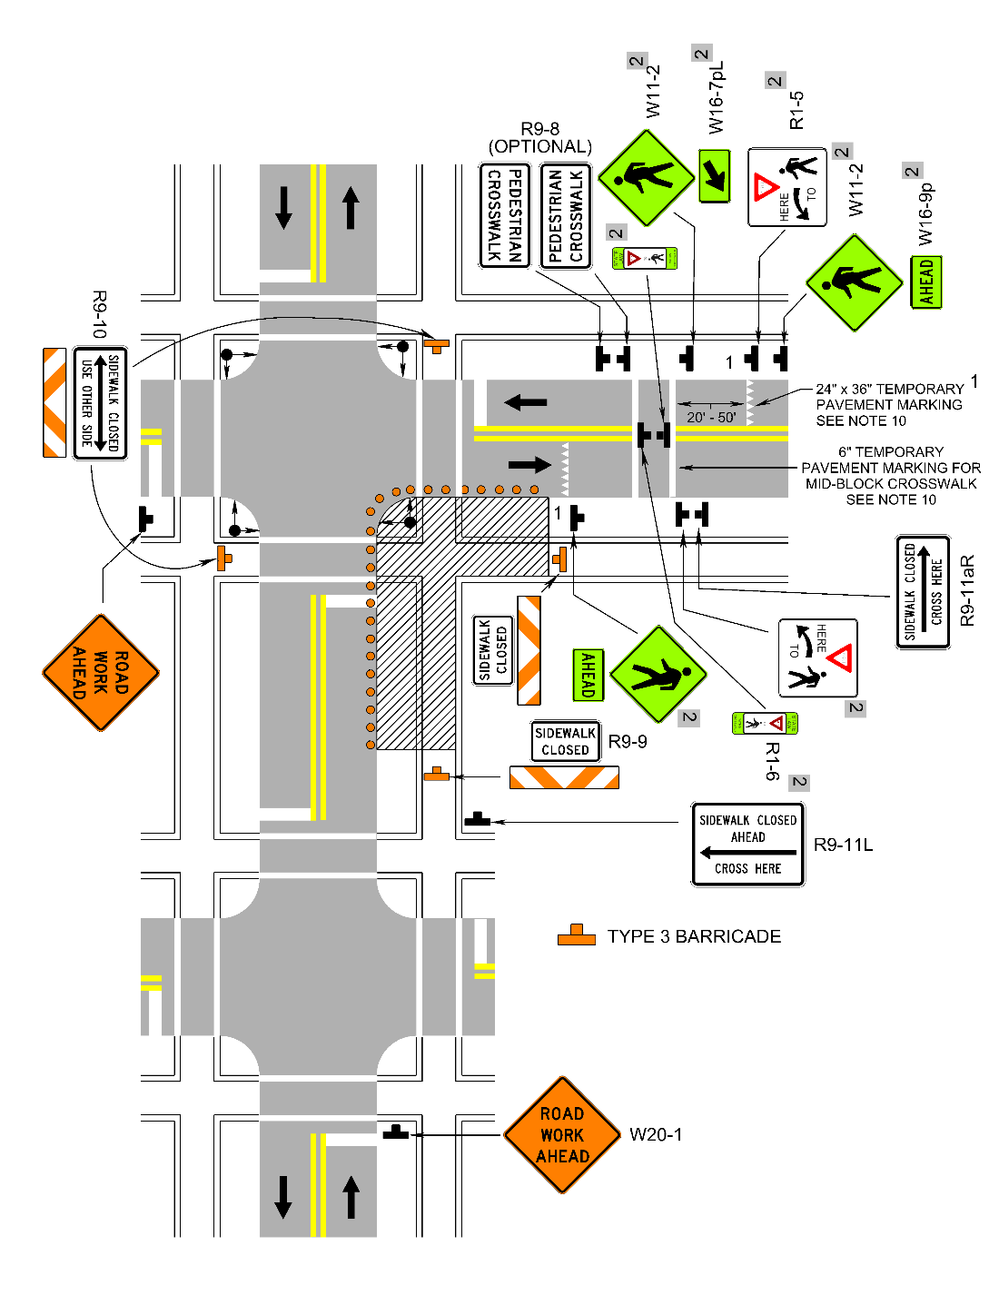
CHAPTER 6H – Typical Applications
TTC-36 - Crosswalk Closure and Pedestrian Detour Operation
  All pedestrian and plaques changed to yellow-green
  Added YIELD HERE TO PEDESTRIAN signs
  Added state law yield to pedestrian sign in the center of the roadway
Notes:
New Pedestrian signs have been added to TTC-36.

Slide 38
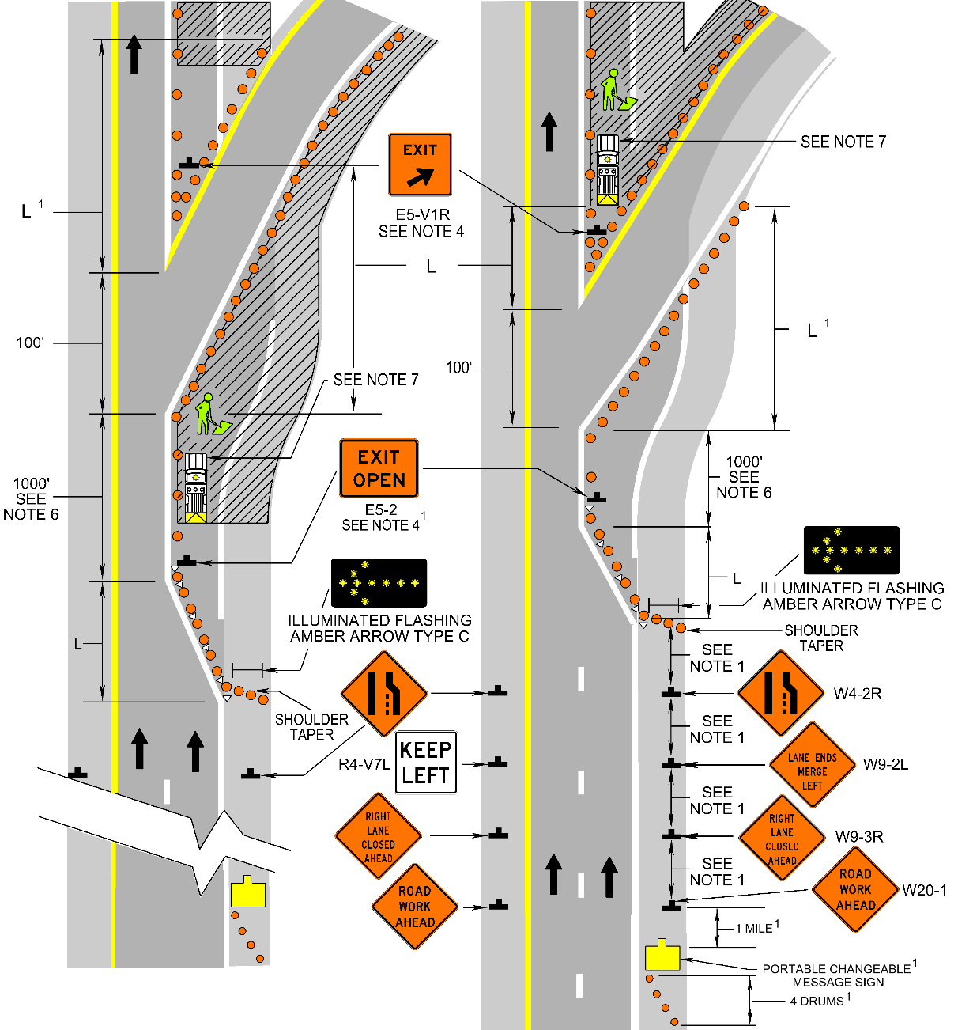
CHAPTER 6H – Typical Applications
TTC-37 - Work Operation in the Vicinity of an Exit Ramp
  Added note requiring drums on both edge lines for the exit taper
Notes:
During reviews of projects at night, many motorist seemed confused at off ramps, some changing their minds and traveling up into the closed lane. Since an exit taper is used at these locations, and tapers at night require the use of drums, thia change was added to clarify that. Once drums were added to the projects that were revised, motorist had a clearer understanding of what they need to do to exit the travelway.

Slide 39
CHAPTER 6H – Typical Applications
TTC-50 - Disruption Operation on a Multi-lane Roadway
  Changed stoppage time to 15 minutes in lieu of 20 minutes
  Lane closure required if flaggers are controlling traffic – flagger controls only one lane
  Lane closure and center lane turn lane must be closed if using flaggers or if performing a slow roll operation
Notes:
For TTC-50, Disruption Operation on a Multi-lane Roadway, the following changes were made:
Changed stoppage time to 15 minutes in lieu of 20 minutes
Lane closure required if flaggers are controlling traffic – flagger controls only one lane
Lane closure and center lane turn lane must be closed if using flaggers or if performing a slow roll operation

Slide 40
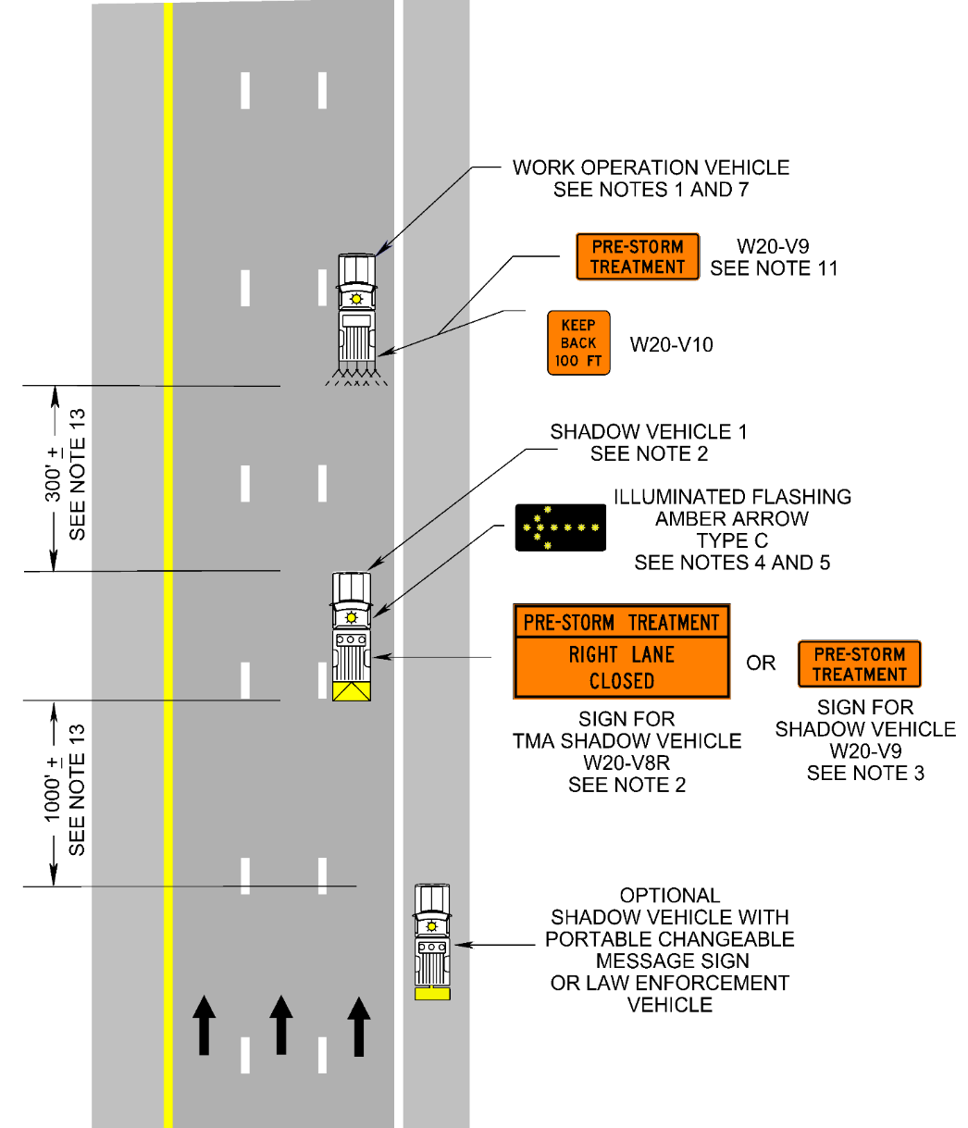
CHAPTER 6H – Typical Applications
TTC-61 – Pre-storm Treatment Operation
  Added the following note for operations which can run near the posted speed limit:
    If the operation can maintain an operating speed of 50 mph or greater, the use of a TMA on the shadow vehicle may be eliminated.
Notes:
The following modification has been made to TTC-61, Pre-storm Treatment Operation:
If the operation can maintain an operating speed of 50 mph or greater, the use of a TMA on the shadow vehicle may be eliminated.

Slide 41
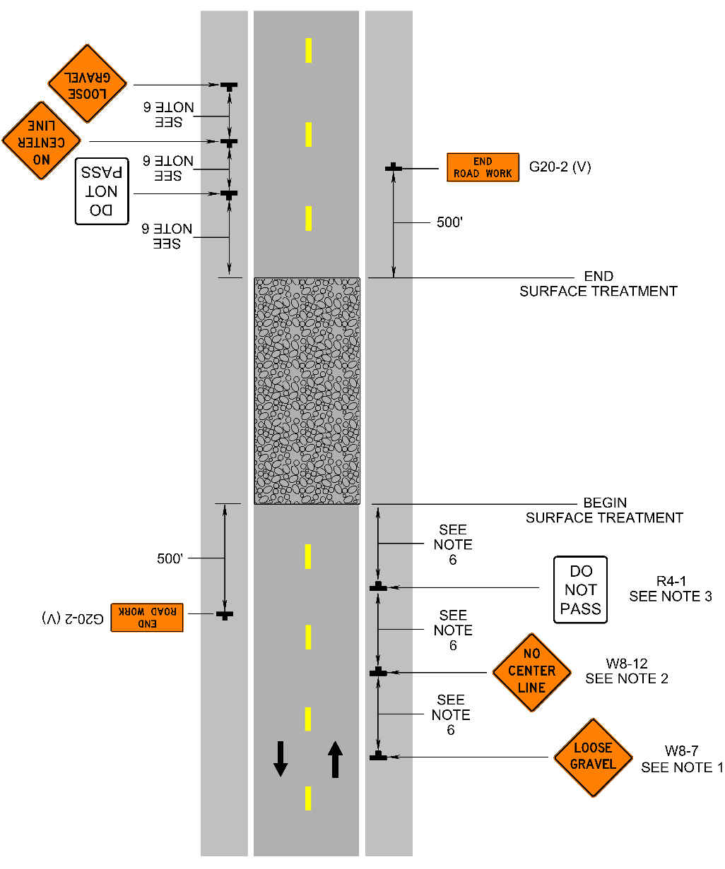
CHAPTER 6H – Typical Applications
TTC-64 - End of Day Signing for Surface Treatment, Slurry Seal and Latex Emulsion Treatment Operations
  Added note for the UNMARKED PAVEMENT AHEAD (W8-4) sign
  Signs shall be erected in advance of resurfaced roadway sections 500 feet or more in length where the center line and edge lines have been removed until pavement marking are applied.
Notes:
TTC-64 - End of Day Signing for Surface Treatment, Slurry Seal and Latex Emulsion Treatment Operations
Added note for the UNMARKED PAVEMENT AHEAD (W8-4) sign
Signs shall be erected in advance of resurfaced roadway sections 500 feet or more in length where the center line and edge lines have been removed until pavement marking are applied

Slide 42
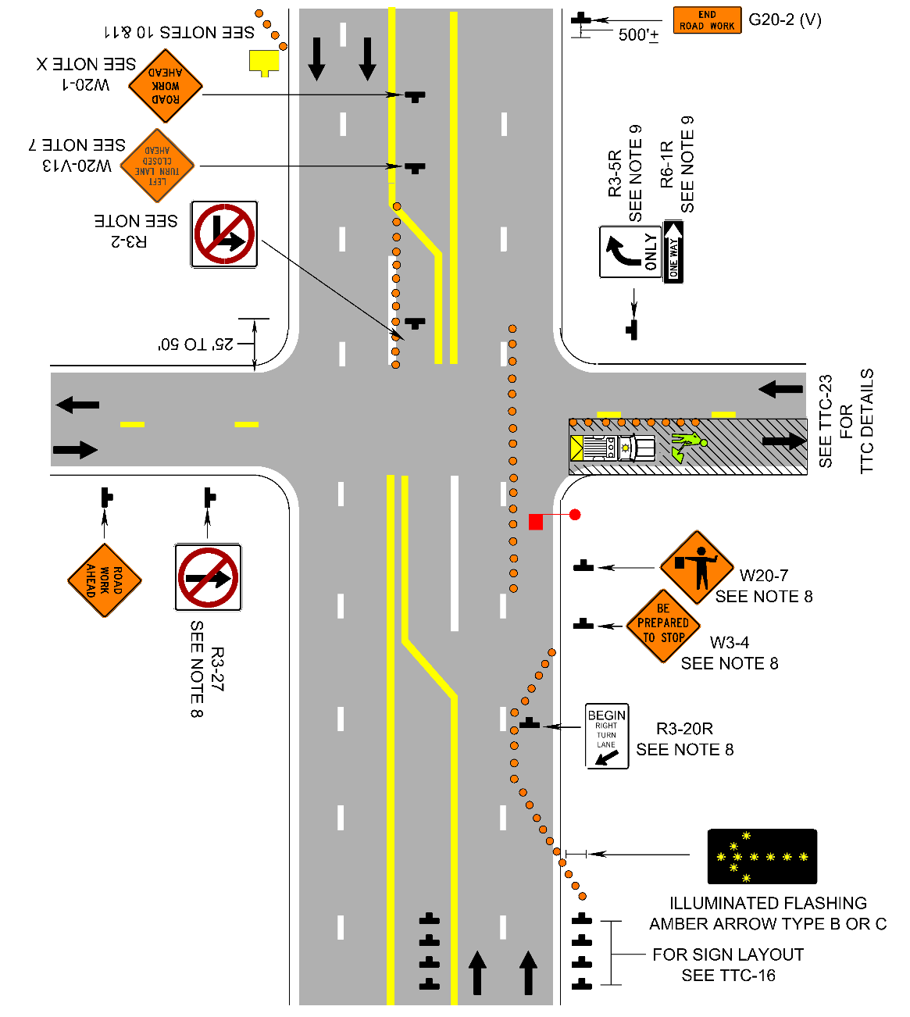
CHAPTER 6H – Typical Applications
New TTC-68.0 - Lane Closure Operation for Flagging Operations on an Intersecting Roadway
Notes:
This TTC was requested to be added by a couple of the districts: Lane Closure Operation for Flagging Operations on an Intersecting Roadway

Slide 43
CHAPTER 6H – Typical Applications
New TTC-69 - Lane Closure on a Two-lane Roadway Using Stop/Slow or Red/Yellow Lens Automated Flagger Assistance Device (AFAD)
Moved typical figures from Section 6E to 6H.
Notes:
As mentioned earlier, the use of AFADs has been made into a TTC with the typical figures moved from 6E to 6H with the rest of the TTC layouts.

Slide 44
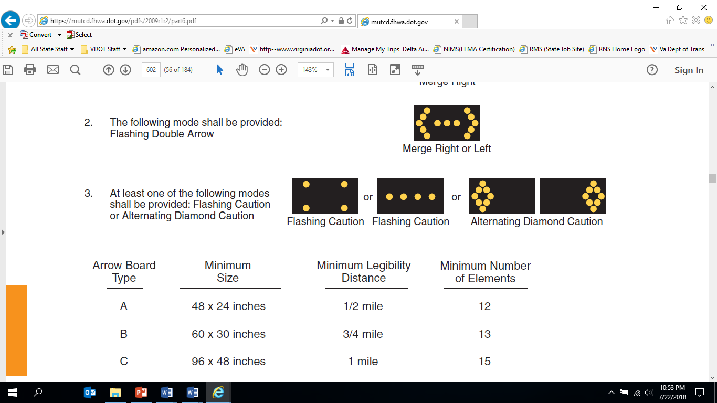
CHAPTER 6I – Control of Traffic Through Incident Management Areas
Standard:
While parked on the shoulder, the Alternating Diamond caution mode shall only be displayed by VDOT/Contractor traffic operations incident management vehicles to assist in distinguishing them from a normal work vehicle. The 4-corner caution mode can be used until June 1, 2023 at which time the Alternating Diamond caution mode shall only be used.
Notes:
This is a change which effect Safety Service Patrol personnel only. It is not to be used for regular road work operations:
While parked on the shoulder, the Alternating Diamond caution mode shall only be displayed by VDOT/Contractor traffic operations incident management vehicles to assist in distinguishing them from a normal work vehicle. The 4-corner caution mode can be used until June 1, 2023 at which time the Alternating Diamond caution mode shall only be used.

Slide 45

WAPM Revision #2 Implementation
Roll Out Dates:
Sept. 1, 2019 - effective for all work performed by State Forces, unless work is under a contract that references Rev. 1 of the WAPM
Will be effective on projects advertised on and after Jan 1, 2020.
Notes:
Revision 2 will be out soon and will be effective for all work performed by State Forces on Sept. 1, 2019, unless work is under a contract that references Rev. 1 of the WAPM
Revision 2 will be effective on projects advertised on and after Jan 1, 2020.

Slide 46
Virginia Work Area Protection Manual
Revision 2 Update
Questions
Notes:
I would be happy to take your questions. If I can’t provide an answer to you, I will contact the Traffic Engineering Division and relay what they say.

Slide 47
Virginia work area protection manual – Revision 2 Update
David Rush
May 28, 2019
Notes:
Thanks and please be safe out there!

